Slide 1

Basics of
HTML5

Slide 2
History of HTML
1991
HTML first published
1995
HTML 2.0
After HTML 4.01 was released, focus shifted to XHTML and its stricter standards.
1997
HTML 3.2
1999
HTML 4.01
XHTML 2.0 had even stricter standards than 1.0, rejecting web pages that did not comply. It fell out of favor gradually and was abandoned completely in 2009.
2000
XHTML 1.0
2002 -2009
HTML5 is much more tolerant and can handle markup from all the prior versions.
XHTML 2.0
HTML5
Though HTML5 was published officially in 2012, it has been in development since 2004.
2012

Slide 3
What is HTML5?
HTML5 is the newest version of HTML, only recently gaining partial support by the makers of web browsers.
It incorporates all features from earlier versions of HTML, including the stricter XHTML.
It adds a diverse set of new tools for the web developer to use.
It is still a work in progress. No browsers have full HTML5 support. It will be many years – perhaps not until 2018 or later - before being fully defined and supported.

Slide 4
Goals of HTML5
Support all existing web pages. With HTML5, there is no requirement to go back and revise older websites.
Reduce the need for external plugins and scripts to show website content.
Improve the semantic definition (i.e. meaning and purpose) of page elements.
Make the rendering of web content universal and independent of the device being used.
Handle web documents errors in a better and more consistent fashion.

Slide 5
New Elements in HTML5
<article>
<aside>
<audio>
<canvas>
<datalist>
<figure>
<figcaption>
<footer>
<header>
<hgroup>
<mark>
<nav>
<progress>
<section>
<source>
<svg>
<time>
<video>
These are just some of the new elements introduced in HTML5. We will be exploring each of these during this course.

Slide 6
Other New Features in HTML5
Built-in audio and video support (without plugins)
Enhanced form controls and attributes
The Canvas (a way to draw directly on a web page)
Drag and Drop functionality
Support for CSS3 (the newer and more powerful version of CSS)
More advanced features for web developers, such as data storage and offline applications.

Slide 7
First Look at HTML5
Remember the DOCTYPE declaration from XHTML?
<!DOCTYPE html PUBLIC "-//W3C//DTD XHTML 1.0 Transitional//EN"
"http://www.w3.org/TR/xhtml1/DTD/xhtml1-transitional.dtd">
In HTML5, there is just one possible DOCTYPE declaration and it is simpler:
<!DOCTYPE html>
Just 15 characters!
The DOCTYPE tells the browser which type and version of document to expect. This should be the last time the DOCTYPE is ever changed. From now on, all future versions of HTML will use this same simplified declaration.

Slide 8
The <html> Element
This is what the <html> element looked like in XHTML:
<html xmlns="http://www.w3.org/1999/xhtml" xml:lang="en" lang="en">
Again, HTML5 simplifies this line:
<html lang="en">
The lang attribute in the <html> element declares which language the page content is in. Though not strictly required, it should always be specified, as it can assist search engines and screen readers.
Each of the world’s major languages has a two-character code, e.g. Spanish = "es", French = "fr", German = "de", Chinese = "zh", Arabic = "ar".

Slide 9
The <head> Section
Here is a typical XHTML <head> section:
<head>
<meta http-equiv="Content-type" content="text/html; charset=UTF-8" />
<title>My First XHTML Page</title>
<link rel="stylesheet" type="text/css" href="style.css" />
</head>
And the HTML5 version:
<head>
<meta charset="utf-8">
<title>My First HTML5 Page</title>
<link rel="stylesheet" href="style.css">
</head>
Notice the simplified character set declaration, the shorter CSS stylesheet link text, and the removal of the trailing slashes for these two lines.

Slide 10
Basic HTML5 Web Page
Putting the prior sections together, and now adding the <body> section and closing tags, we have our first complete web page in HTML5:
<!DOCTYPE html>
<html lang="en">
<head>
<title>My First HTML5 Page</title>
<link rel="stylesheet" href="style.css">
</head>
<body>
<p>HTML5 is fun!</p>
</body>
</html>
Let's open this page in a web browser to see how it looks…

Slide 11
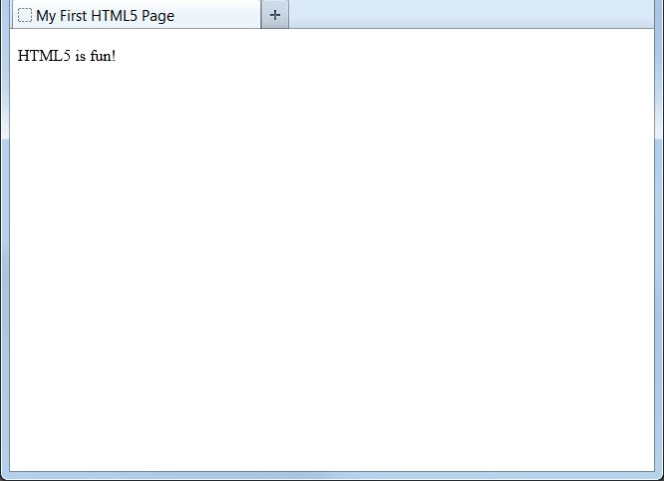
Viewing the HTML5 Web Page
Even though we used HTML5, the page looks exactly the same in a web browser as it would in XHTML. Without looking at the source code, web visitors will not know which version of HTML the page was created with.

Slide 12
HTML5 – Web Storage
With web storage, web applications can store data locally within the user's browser.
Before HTML5, application data had to be stored in cookies, included in every server request. Web storage is more secure, and large amounts of data can be stored locally, without affecting website performance.
Unlike cookies, the storage limit is far larger (at least 5MB) and information is never transferred to the server.
Web storage is per origin (per domain and protocol). All pages, from one origin, can store and access the same data.

Slide 13
HTML5 – Web Storage
HTML web storage provides two objects for storing data on the client:
  window.localStorage - stores data with no expiration date
  window.sessionStorage - stores data for one session (data is lost when the browser tab is closed)

Slide 14
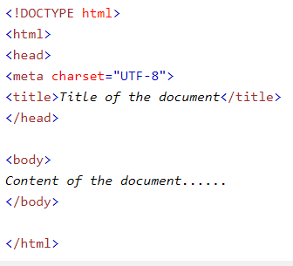
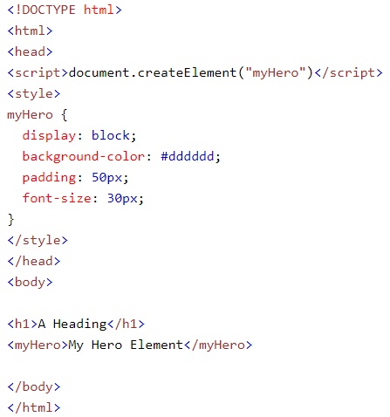
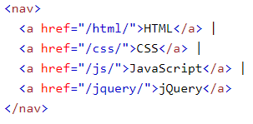
HTML5 – Examples - 1

Slide 15
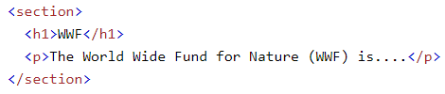
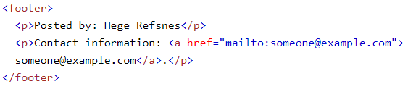
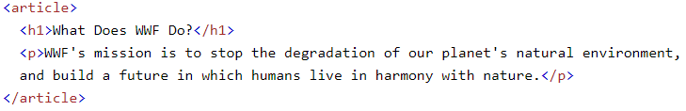
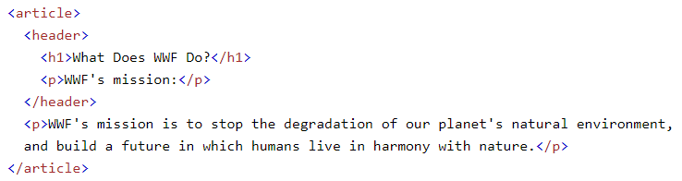
HTML5 – Examples - 2

Slide 16
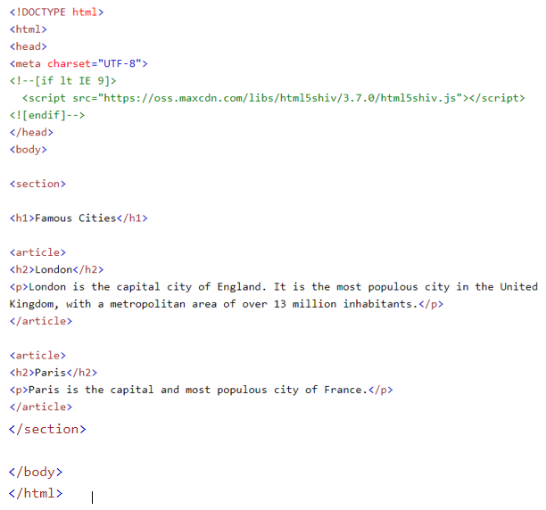
HTML5 – Examples - 3

Slide 17
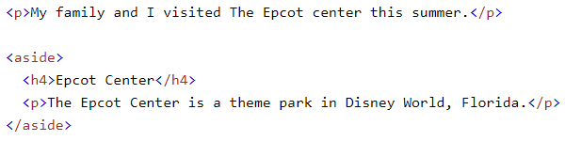
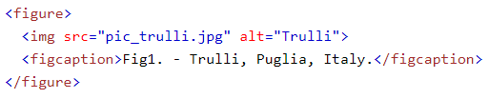
HTML5 – Examples - 4

Slide 18
HTML5 – Coding Conventions
Be Smart and Future Proof
Use Correct Document Type
Use Lower Case Element Names
Close All HTML Elements
Close Empty HTML Elements
Use Lower Case Attribute Names
Quote Attribute Values
Image Attributes
Spaces and Equal Signs
Avoid Long Code Lines
Blank Lines and Indentation

Slide 19
HTML5 – Coding Conventions
Omitting <html> and <body>?
Omitting <head>?
Meta Data
Setting The Viewport
HTML Comments
Style Sheets
Loading JavaScript in HTML
Accessing HTML Elements with JavaScript
Use Lower Case File Names
File Extensions

